Slide 1
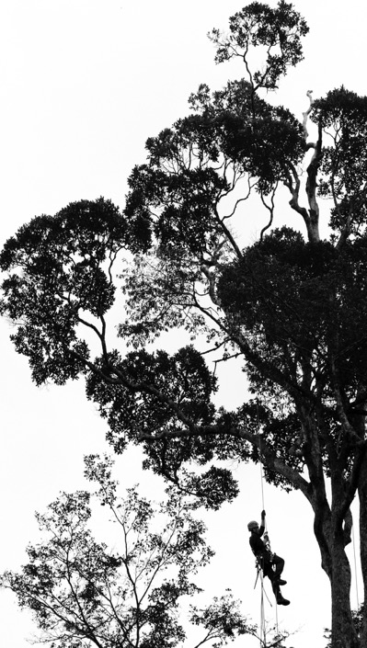
Properties of a stochastic model of macroevolution with protracted speciation
Jérôme Chave
EDB CNRS-Université Paul Sabatier, Toulouse

Slide 2
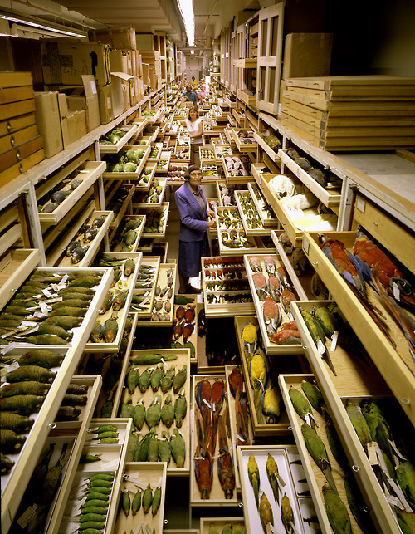
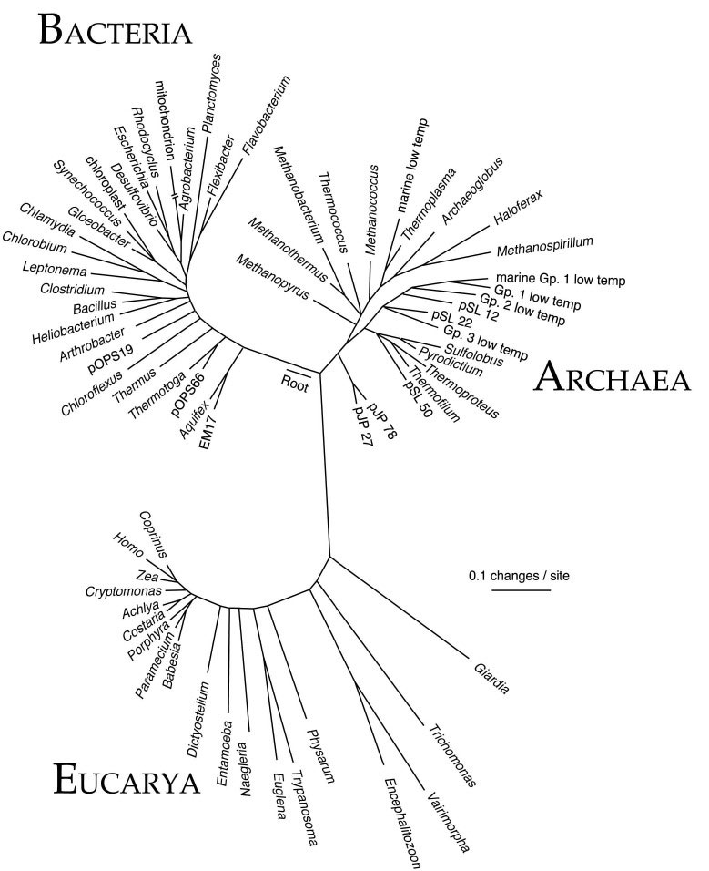
The biodiversity challenge
Pace, Science (1997)

Slide 3
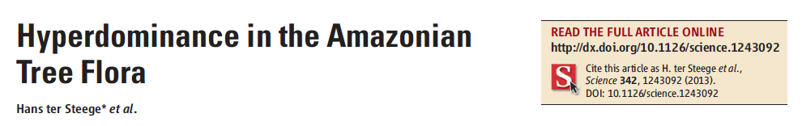
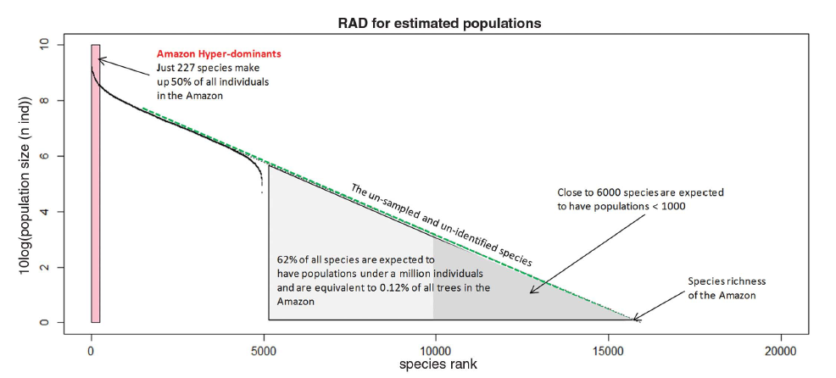
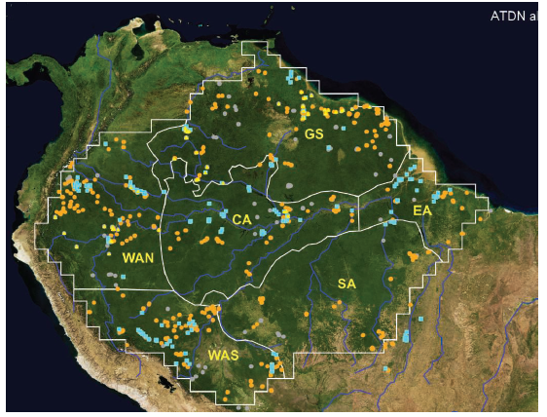

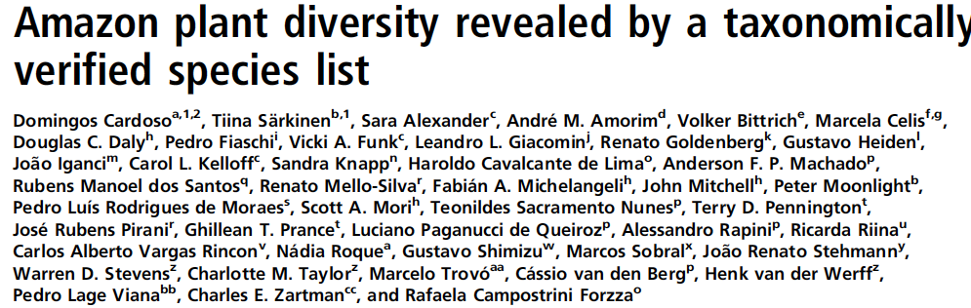
Problem with counting species
2013
1430 permanent plots
2017

Slide 4
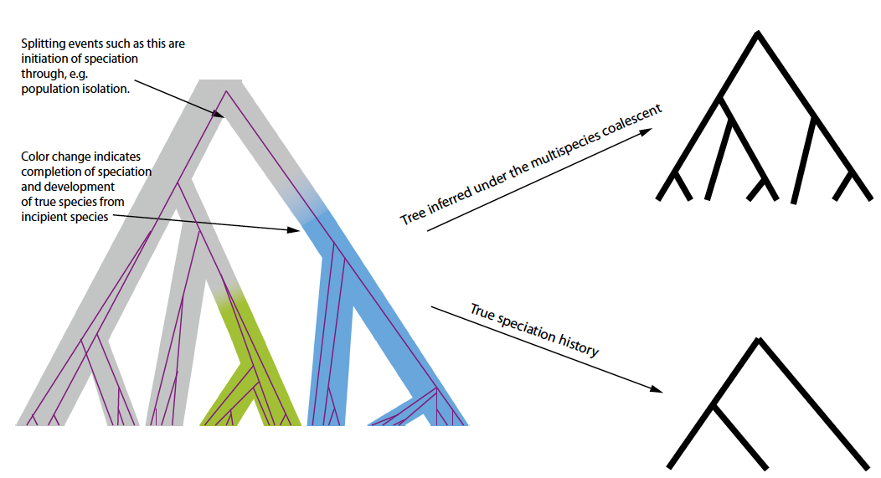
Problem with placing species within a phylogenetic context (and defining species)
Sukumaran & Knowles PNAS (2017)

Slide 5
Neutral theory of biodiversity and biogeography
The regional species pool
Probability 1- ν
Probability ν
θ = n ×ν
n: number of individuals in the regional species pool
ν : speciation rate

Slide 6
Predictions of the neutral theory
The same model predicts
The shape of a species abundance distribution (useful to ecologists)
The shape of phylogenetic trees (useful to macroevolutionists)
For that reason it is an attractive model in biodiversity research

Slide 7
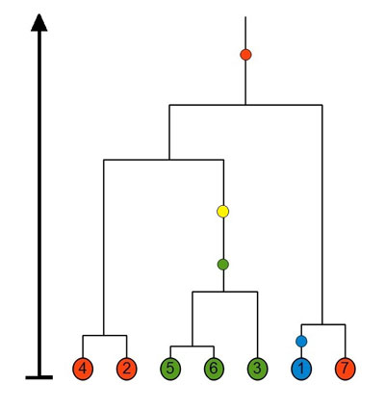
Method to construct multispecies trees from the neutral theory
Coalescence event
Hits with an intensity θ
Incomplete lineage sorting

Slide 8
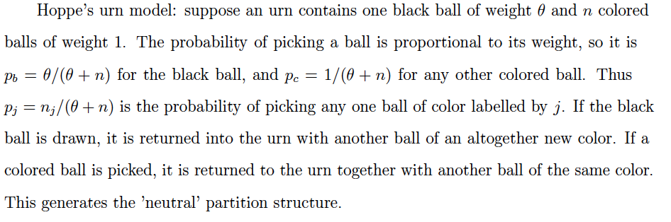

Urn construction of species abundance distributions
Random partitions of samples of individuals in the neutral model are equivalent to random partitions generated by Hoppe’s urn scheme (Hoppe 1984)
It follows that the expected number of species S_{n} for a sample of n individuals is such that

Slide 9
Broken stick construction
Another way to look at the same problem is to consider the forward in time neutral model (Fisher-Wright or Moran model with mutation) which assumes that n→∞
In that case the equilibrium distribution of relative species abundances is given by a Dirichlet process (see e.g. Watterson Theoretical Population Genetics 1976)
Relative species abundance complying to a Dirichlet process (i.e. ‘drawn’ from this process) may be generated through a simple procedure (Griffith, Engen & McCloskey, or GEM construction)
This is called the ‘broken stick’ construction because it is like breaking a stick of unit length at a location given by W₁, then cutting the remaining stick (of length 1-W₁) at a relative location W₂ (so the weight is W₂(1-W₁) ) and so forth.
This is mentioned only in passing here, but this is an important property in nonparameteric Bayesian estimation, to define priors in classification/clustering problems (Ferguson 1973).

Slide 10
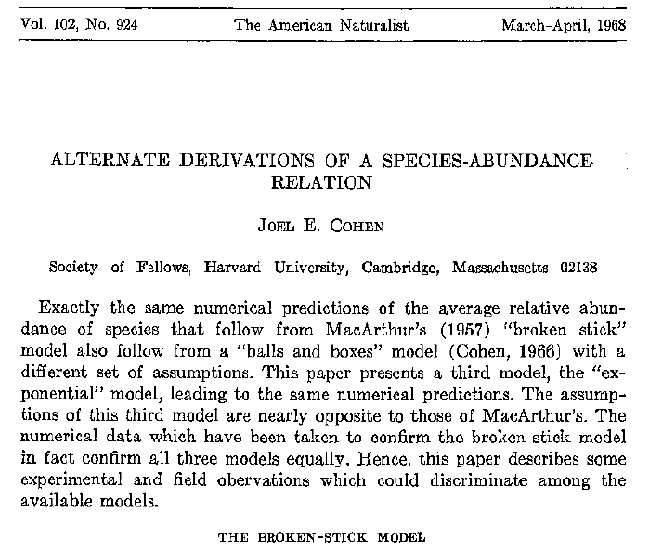
An interesting historical paper

Slide 11
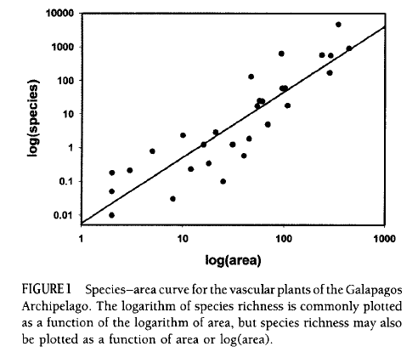
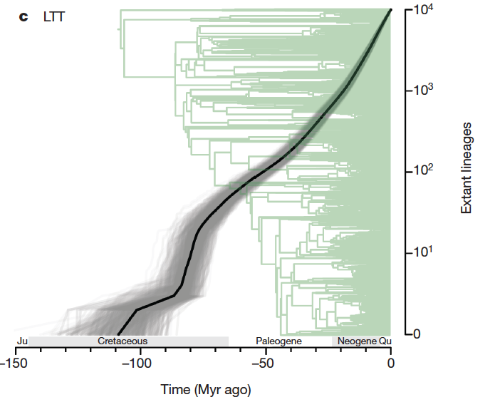
Where neutral theory fails
Empirical species accumulation curves are often power-law, not logarithmic
The neutral model with point speciation produces too many rare species, and drift is too slow to wipe away abundant species (Ricklefs 2003, Nee 2005)

Slide 12
Hubbell’s proposal
Speciation rate θ
Regional pool
Immigration: m
(dispersal-limited) local sample
This model does a nice job at predicting species abundance distributions, but still has problems reconciling ecological and macroevolutionary timescales
Hubbell The unified neutral theory of species abundance and diversity (2001)
See Harris et al. IEEE (105, 2017) for a nice general treatement of this model

Slide 13
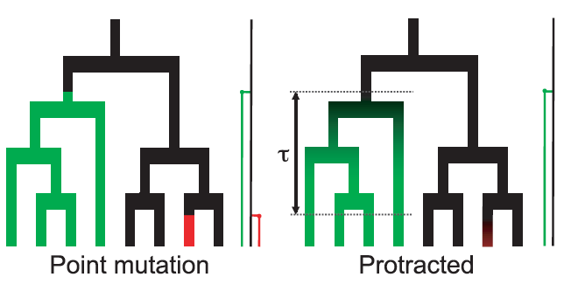

One solution: protracted speciation
In a forward in time (Moran-type) model, where P(j,t) is the number of species with abundance j at time t
Where ν = μ/(1+τ) is the speciation rate, and τ is the time lag to turn a lineage into a proper species.
Rosindell et al. Ecol Lett (2010)

Slide 14
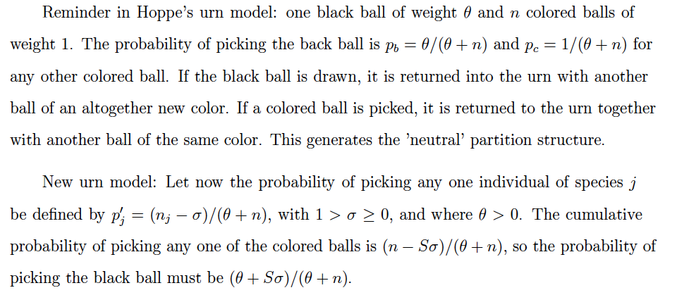
Another possible protracted model: urn construction
Pitman, J. (1996). Some developments of the Blackwell-MacQueen urn scheme. Lecture Notes-Monograph Series, 245-267.

Slide 15
Intuitive idea
In a forward-in-time approach, this model allows for the genesis of as many species as in the ‘classic’ neutral model (θ is unchanged), but it makes it harder for the rare species to survive (they are picked more rarely, and could go extinct).
Note: this model generates a partition structure that is a ‘natural’ two-parameter generalization of the neutral model [Pitman and Yor 1992]

Slide 16
Broken stick construction
Reminder (from a few slides above): The construction of a relative species abundance may be done using the following (GEM) procedure
[Pitman 1995] A similar construction exists for the two-parameter model
J. Pitman. Exchangeable and partially exchangeable random partitions.
Probability Theory and Related Fields, 102:145–158, 1995

Slide 17

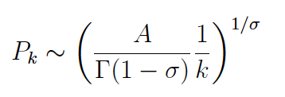
Some asymptotic results
[Pitman 1996] As n→ ∞, almost surely
[Pitman 1996] Let us rank the species from the most to the least abundant in a sample generated by the model above, and write P(k) for the abundance of the kth species, then as n→ ∞
As σ→0, convergence towards the neutral partition structure (and log-series species abundance distribution) is assured
Pitman, J. (1996). Lecture Notes-Monograph Series, 245-267.

Slide 18
What type of multispecies tree does this model generate?
Polytomies are not rare in multispecies trees, and they partly reflect the complex, reticulated history of genes

Slide 19
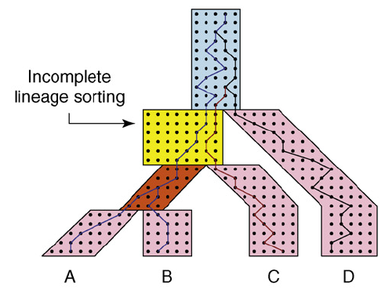
Realistic multispecies coalescents
Degnan and Rosenberg TREE (2009)

Slide 20
One possible idea: synchronous speciation events
Bifurcation
Trifurcation
…
The coalescent interpretation means that multiple particles are allowed to collide at once.
More precisely, if b particles are present, the probability that k of them collide is defined as λ_{k,b}.
In the case λ_{2,b} = 1, λ_{k,b} = 0 for all k≠2, this is equivalent to the neutral coalescent (see above)
Berestycki, N. (2009). Recent progress in coalescent theory. Ensaios Matematicos, 16(1), 1-193.

Slide 21
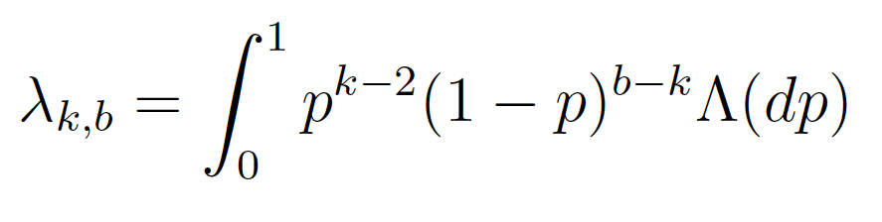
Theory for this model
Representation theorem (Pitman 1999). Defining Λ(x) to be a finite measure on [0,1], the λ_{k,b} are uniquely defined by
And this is called a Λ-coalescent (equal to the ‘neutral’ coalescent if Λ=δ)

Slide 22
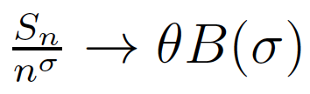
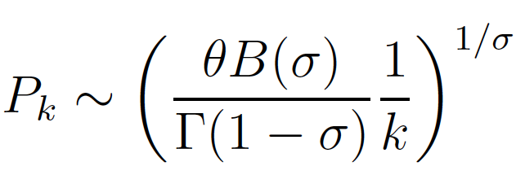
Asymptotic results
Results [Berestycki, Berestycki & Limic 2014]
Assume a Λ-coalescent is constructed and n leaves are sampled.
Assume ‘speciation’ events are drawn upon the tree at a (Poisson) rate θ.
Assume that Λ(dx)~Ax^{σ−1}dx, with 1>σ≥0
Then:
(B(σ) is a known function)
Berestycki, J., Berestycki, N., & Limic, V. (2014). Asymptotic sampling formulae for Λ-coalescents. In Annales de l'Institut Henri Poincaré, Probabilités et Statistiques (Vol. 50, No. 3, pp. 715-731). Institut Henri Poincaré.

Slide 23
Summary
Two-parameter random-partition model
Λ-coalescent

Slide 24
Questions
Is there an equivalence between the Λ-coalescent sampling scheme and the Pitman sampling formula?
Is there a generative process for the random partition created in the Λ-coalescent?

Slide 25
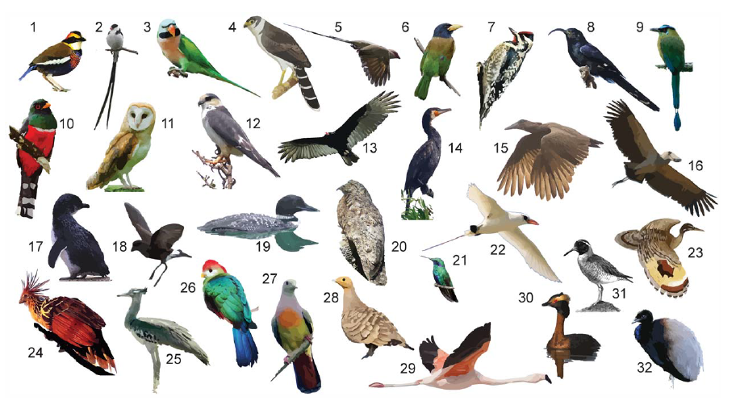
Work ahead: a case for birds
McCormack et al. Plos Biol (2013)

Slide 26
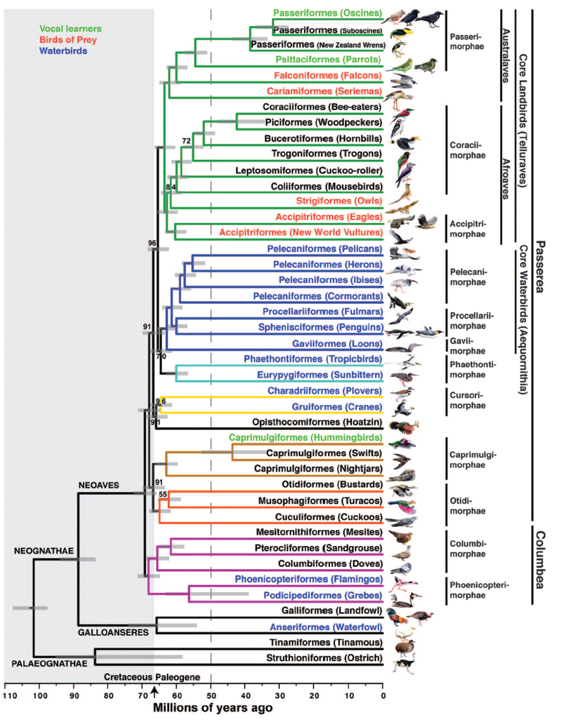
Exploring the polytomies of a phylogeny
Jetz et al. Nature (2012)
Jarvis et al. Science (2014)

Slide 27
Idea
Compute the values of λ_{k,b} for k=2, k=3, k=4, and infer σ by inverting

Slide 28
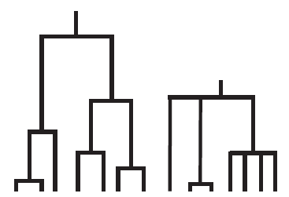
Thank you
jerome.chave@univ-tlse3.fr

